Slide 1

Área Académica:
INGLES A 1.1 Tema:
TALKING ABOUT ABILITIES
Profesor: MARCELA CAMACHO IBERRI Periodo: ENE-JUN 2015

Slide 2

Tema: TALKING ABOUT ABILITIES
Abstract:
“Can" is one of the most commonly used modal verbs in English. It can be used to express ability or opportunity, to request or offer permission, and to show possibility or impossibility.
The difference between can and do here is very slight.
"Can" focuses on ability, whereas "do" indicates regular activity.
.KEY WORDS: CAN

Slide 3
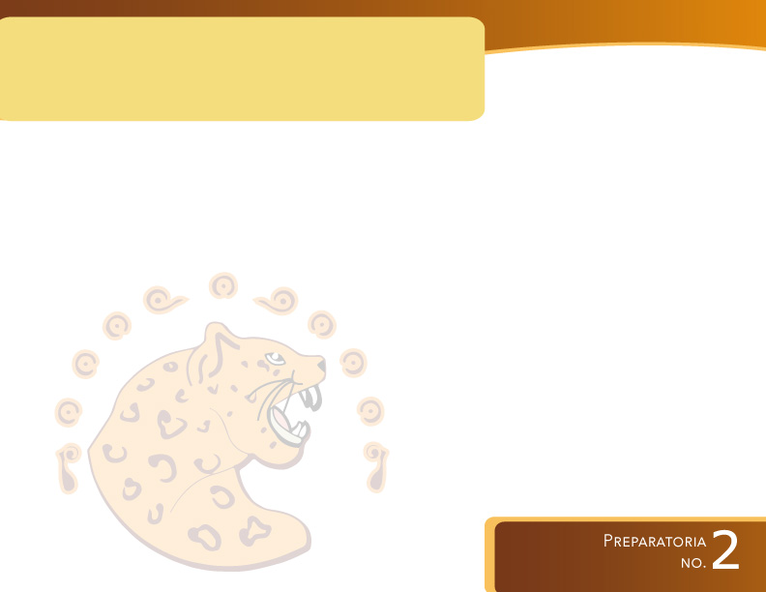
COMPETENCIA(S) DE LA UNIDAD:
Produce textos y/o composiciones coherentes y creativas, con base en el uso normativo de la lengua, considerando la intención y situación comunicativa

Slide 4
OBJETIVO
Describe proyectos y aspiraciones personales así como las habilidades que se poseen.

Slide 5
. Tell your classmates about your best friend's talents or interests
Can you play a musical instrument?*
Yes, I play the trumpet.
How well do you play?
So-so.
Do you ski?*
No, I don't.
How about other winter sports?
I love to play ice hockey.

Slide 6
Match the occupation with the daily activity.
Ocupation | Activity
Mechanic Teacher Dentist Doctor/Nurse Journalist Fisherman Gardener Chef/Cook Fire fighter Photographer | catch fish take pictures fix cars cook meals pull teeth plant flowers put out fires take care of patients teach classes write news stories

Slide 7
Complete the conversation. Use the prompts .
fix cars mechanic
A: What do you do for a living? A: What is your occupation?
B: I'm a_______________.
A: A________________? That must be a lot of work.
B: It is. Every day I ________ _________.
A: How interesting. How many________ do you ______?
B: I ________ about eight _______ every day.

Slide 8

Using the Verb 'Can'

Slide 9
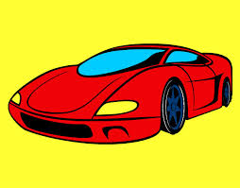
We use can to talk about things we can do.
I can drive.
I can give you a lift to college.
I can give you a lift home.

Slide 10


We use can't to talk about things we are unable to do.
You can't smoke in here.
You can't park here.

Slide 11
TASK
Talk about the abilities have these people:
A mechanic
A doctor
A journalist

Slide 12
BIBLIOGRAPHY
WIKIPEDIA: http://www.eslgold.com/speaking/talking_about_abilities.html. Recuperado en 2015 http://www.esolcourses.com/uk-english/beginners-course/unit-3/asking-for-things/beginners-grammar-using-can.html.
Recuperado en 2015

